Slide 1
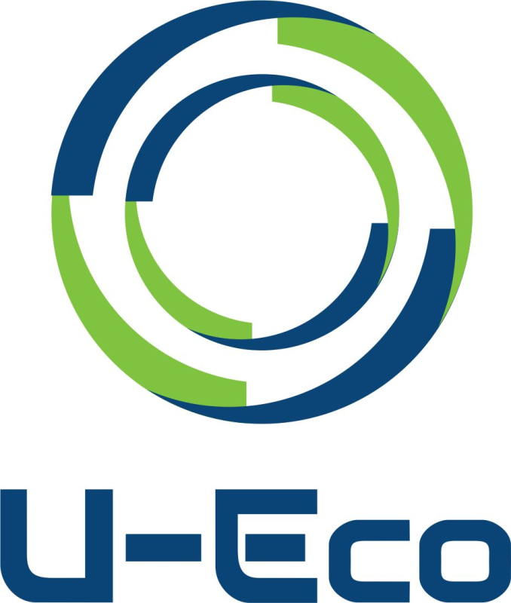
Upskilling for more creative circular economy U-Eco
Learning from real life
13 Case Studies with Circular Best Practices

Slide 2
U-ECO Upskilling for more creative circular economy
IO2 Learning from real life
CASE STUDIES IDENTIFIED
Atelier - Construction and Demolition page 2
Recordarium - Construction and Demolition page 9
Margent Farm - Construction and Demolition page16
Cicle centre - Digitalization, Sharing Platforms, and Services page 23
Eco cheques - Digitalization, Sharing Platforms, and Services page 30
SomEnergía - Digitalization, Sharing Platforms, and Services page 37
Bio&Co - Food and Biomass (Agriculture, Forest, Food and Energy) page 46
Municipal Waste Management Program in Krakow - Food and Biomass (Agriculture, Forest, Food and Energy) page 53
Lufa Farms - Food and Biomass (Agriculture, Forest, Food and Energy) page 60
Recupel - Plastics, Secondary Materials, and Innovation page 68
Siptex - Plastics, Secondary Materials, and Innovation page 75
Water2return - Water Treatment and Reuse page 83
Proeko - Water Treatment and Reuse page 91

Slide 3
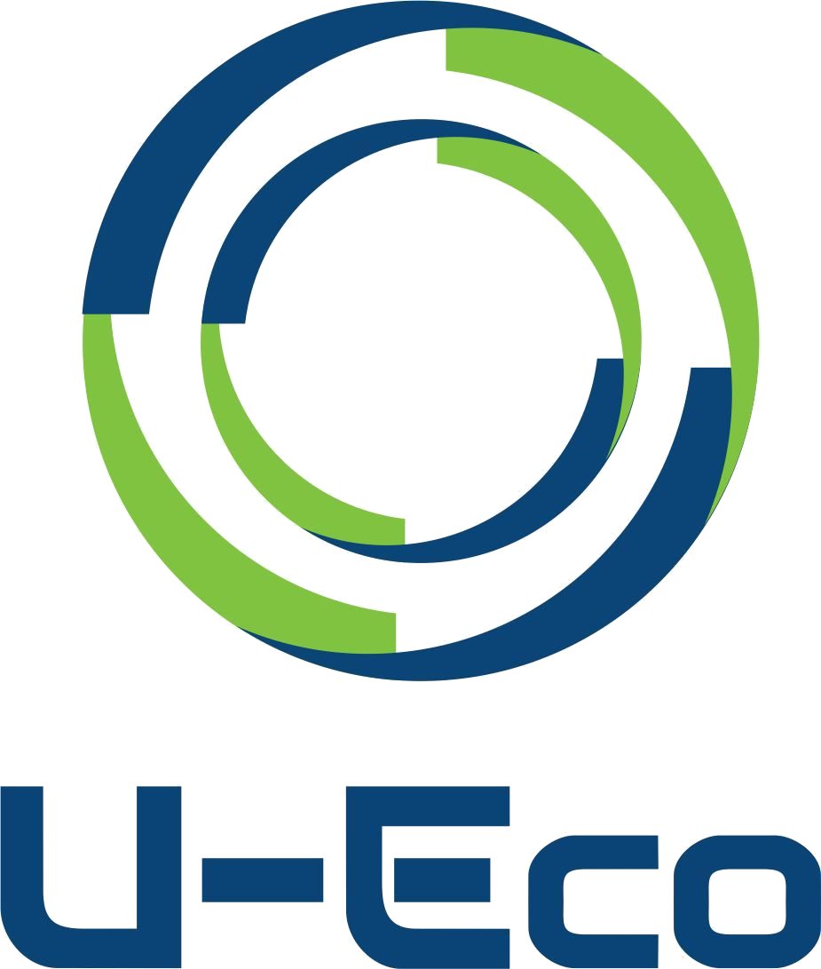
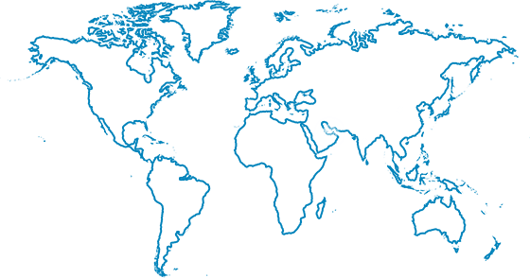
Atelier
Construction and Demolition, Romania

Slide 4
Brief overview of the Case Study
Challenge
Value proposition
How to generate enough heat for comfort while reducing energy usage and costs
Atelier’s understanding of energy problems is multi-lateral and seeks to help individuals, the environment, and economic needs
Impact or economic information
Description
The impact made on individuals is personal (better health conditions thanks to better air) and economic (lower energy usage costs)
Atelier uses “passive energy” to recycle naturally generated heat

Slide 5
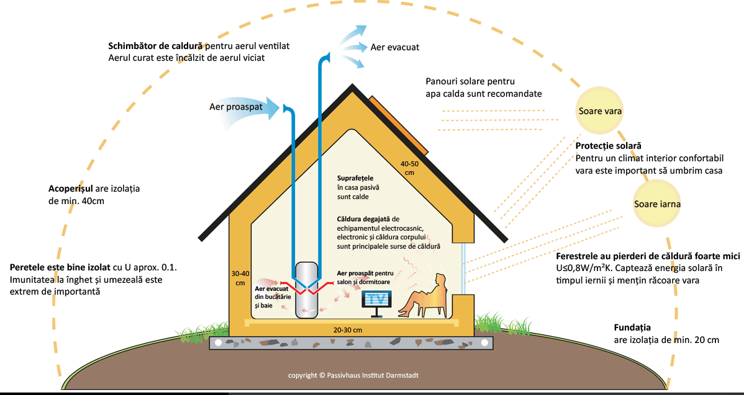
Description of the Case study
The Atelier “passive house” effectively places together the thermal comfort people actively want with a reduced energy consumption that translates into an economic and environmentally friendly proposition. The “passive” energy is recycled from various places- such as rooms in the house that are naturally warmer, solar energy, and the occupants of the house who produce thermal warmth. The minimum amount of heat needed is provided by a ventilation system with heat recovery.
The construction of a passive house, in addition to the effective design, which respects certain principles, involves a series of complex calculations of energy modelling of the building in a program specially designed for passive buildings (PHPP) and numerical modelling of thermal bridges. The resulting project is of a superior quality, precisely due to these computer simulations, of the building's behaviour over time, and problems can be foreseen and cancelled in terms of the physical behaviour of the future building (atelier1.ro)

Slide 6
Value proposition
Atelier’s value is economic and environmental: its “passive house” uses 75% less energy than a normally heated house. By recycling energy, it reduces C02 emissions and the use of fossil fuels, as well as protects the environment.

Slide 7
What makes it circular?
Circular inputs
Atelier harnesses “passive energy” from such places as: the sun, people within a “passive house”, and the heat found within rooms of the house. This heat is recovered and used to completely heat the house.

Slide 8
Environmental and economic impact
For the construction of a passive house, the extra-investment in materials with a higher performance does not exceed 10-15% compared to the investment in a conventional building (pressone.ro)
“The additional costs required for a passive house are recovered in 5-10 years of use of that building, precisely by the low energy consumption“ (pressone.ro)
Passive houses conserve fossil fuel resources by using alternative energy forms
Atelier systems filter air within a house throughout the day. Individual health is positively impacted as breathing is less inhibited by allergens and asthma-triggers.

Slide 9
References and useful info
References:
Atelier1: http://atelier1.ro/servicii/proiectare-case-pasive
Garaiman, R,(2017), What it is and how to build a passive house[Online], Available at:https://pressone.ro/ce-este-si-cum-se-construieste-o-casa-pasiva
Useful info:
https://pressone.ro/ce-este-si-cum-se-construieste-o-casa-pasiva
https://aov-architecture.ro/ce-sunt-casele-pasive
The related content to this case study has been identified from the public information which is published by the owners of the content.
Disclaimer:
The European Commission support for the production of this publication does not constitute an endorsement of the contents which reflects the views only of the authors, and the Commission cannot be held responsible for any use which may be made of the information contained therein.

Slide 10
Recordarium
Funeral Services, identified under the category of Construction and Demolution
Spain

Slide 11
Brief overview of Recordarium
Challenge
Value proposition
The funeral industry has a deep negative impact on the environment, with direct consequences such as emissions, waste of water and constant combustion
An ecological alternative to burials, where the ashes from the cremated person biodegrade in the earth and serve as fertiliser for the trees and flora.
Impact or economic information
Description
Development of a forest which will serve as a basis for the spreading of the ashes from the incineration of our beloved ones.
Reduction in emissions and the use of fossil fuels, creation of green jobs, increase human well-being

Slide 12
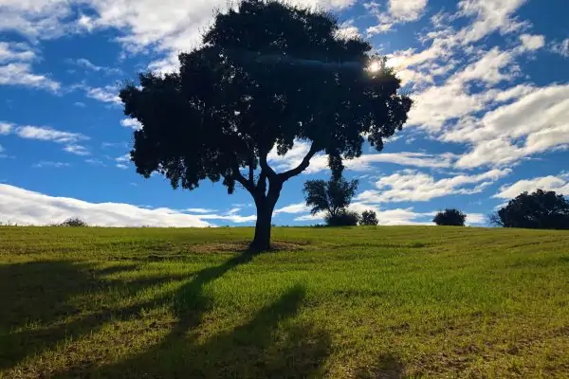
Description of Recordarium
In 2019, 417,625 people died in Spain. An average of 1,144 deaths occur each day in Spain, a country with 47 million inhabitants (España - Mortalidad 2019, 2020). 41% of the population already chooses cremation these days, and this share is predicted to rise to 56% by 2025 ('Recordarium', el final ecológico, sostenible y legal para las cenizas de un ser querido, 2020)
This industry is quite polluting and its consequences are harmful to public health and the environment. The direct consequences are the production of greenhouse gases through the combustion of fossil fuels in funeral homes, crematoriums, and other such facilities. Indirect effects, associated with the funeral home but physically occuring elsewhere, include: the wood used to make coffins, the chemicals used in thanatopraxy (body preservation), and the emissions associated with the management of other waste generated
Recordarium is just 30 minutes away from Madrid (Spain). It is a place dedicated to the memory of those who are not with us anymore. A natural environment made up of forests, vineyards, fields and lakes. It is a place where the ashes are used as biodegradable fertilizer for the trees, so that in each tree the positive memory survives and the cycle of life continues. It is a legal alternative to depositing the ashes in a natural and ecological way.
It helps reforestation, recuperation and maintenance of a natural environment by planting native trees and flora.
Recordarium is open to every person, respecting every belief. The families can decide their preferred type of ceremony, it being possible to play music, recount memories of the person’s life, and share a video stream, among other services.
(Recordarium, 2020)

Slide 13
Value proposition
Recordarium offers a legal and ecological alternative to say goodbye to those who have departed. The clients can choose either to bury the ashes in a biodegradable urn or directly spread the ashes in their favorite part of the facilities. It is a space in nature, a reforestation area, a garden for depositing the ashes of loved ones. It offers an eco-friendly way to become part of the circle of life. In addition, it decreases the amount of land being used for graveyards, which prevent that land being used for other purposes, and imposes no maintenance or land rental costs on the families of the deceased.

Slide 14
What makes it circular?
The main idea of Recordarium is to allow those who have passed away to return to nature by using their ashes as ecological fertiliser, promoting reforestation and flora maintenance.
The main building which Recordarium use on-site is intended to achieve 100% ecological efficiency and sustainability. They have opted for it to be a lightweight, modular construction without foundations or concrete, which therefore does not harm the environment.
The building has only one floor, so it does not cause visual contamination and integrates well with its environment as part of the landscape.

Slide 15
Environmental and economic impact
Use of renewable energy through photovoltaic and thermal solar panels. Aerothermal heating and cooling system.
Ecological mission involving replanting local trees and plants.
Natural supply of water from their own well, with water pumped up during the hours in which they produce energy in order to make maximum use of renewable energy. Wastewater evacuation with compact anaerobic purification.
Contribution to the UN Sustainable Development Goals (SDG’s):
SDG 6: Clean water and sanitation
SDG 7: Affordable and clean energy
SDG 8: Decent work and economic growth
SDG 9: Industry, innovation and infrastructure
SDG 12: Responsible consumption and production
SDG 13: Climate action
SDG 15: Life on land

Slide 16
References and useful info
References:
datosmacro.com. 2020. España - Mortalidad 2019. [online] Available at: <https://datosmacro.expansion.com/demografia/mortalidad/espana#:~:text=En%202019%20murieron%20en%20Espa%C3%B1a,poblaci%C3%B3n%20en%20Espa%C3%B1a%20por%20sexos> [Accessed 3 December 2020].
Nius Diario. 2020. 'Recordarium', El final ecológico, sostenible y legal para las cenizas de un ser querido. [online] Available at: <https://www.niusdiario.es/sociedad/recordarium-espacio-bosque-recuerdo-cenizas-ecologico-sostenible_18_3033720043.html> [Accessed 4 December 2020].
Recordarium - Donde descansarán las cenizas de tu ser querido. 2020. Enterrar o esparcir las cenizas de tu ser querido en Recordarium. [online] Available at: <https://www.recordarium.com/> [Accessed 3 December 2020].
The related content to this case study has been identified from the public information which is published by the owners of the content.
Disclaimer:
The European Commission support for the production of this publication does not constitute an endorsement of the contents which reflects the views only of the authors, and the Commission cannot be held responsible for any use which may be made of the information contained therein.

Slide 17
MARGENT FARM: FLAT HOUSE
Construction and Demolition
Identified case study from the research at International level (UK)

Slide 18
Brief overview of the Case Study
Challenge
Value proposition
Many of the core materials used in construction are carbon intensive and also difficult to separate and reuse at their end of life stage.
Development of an innovative bio-based material, “hempcrete”, using their own crop, to use on construction.
Impact or economic information
Description
Flat House is located on Margent Farm, a 53-acre farming facility that aims to show off the capabilities of hemp – a fast-growing strain of the cannabis plant.
Hemp is increasingly being employed as an eco-friendly building material because of its ability to sequester carbon.

Slide 19
Description of the Case study
Margent Farm’s farmhouse, Flat House, was designed by Practice Architecture and made of ‘hempcrete’ (a mixture of hemp and lime) produced from their first year’s crop.
Flat House was designed with the aim of prototyping pre-fabricated sustainable hemp-based construction to be applied to larger scales of house-construction.
Working closely with engineers and material specialists they developed a prefabricated panel infilled with hemp grown on 20 acres of the farm (dezeen.com, 2020).
The hemp plant’s long tap roots can also help to regenerate the soil by channeling water deeper and holding the soil structure in place. The ‘hempcrete’ was created from farm waste and hemp fibers and the property is powered by a sustainable biomass boiler and energy from the sun (Bitc.org.uk., 2020) .
Fig 1. Margent Farm Flat House

Slide 20
Value proposition
The Flat House project was approached from the perspective of using the raw material that was grown on the farm (farm waste and rests of hemp fibers) and demonstrating how hemp-based products can be used as more sustainable building materials.

Slide 21
What makes it circular?
Circular inputs
Hempcrete was created as a way to use farm waste and rests of hemp fibers.
The property is powered by a sustainable biomass boiler and energy from the sun, so it is powered by renewable energy sources.
The Flat House was built with the aim of having a construction that retains more carbon that what it consumes.
Resource recovery
The Flat House is designed to be disassembled so that at the end of it’s life the materials can be separated to be reused.

Slide 22
Environmental and economic impact
Hemp is increasingly being employed as an eco-friendly building material because of its ability to sequester carbon.
The Flat House can serve as inspiration for sustainable construction and material innovation
The house is also off-grid, with heating and power provided by a biomass boiler and a photovoltaic (PV) array – a system of solar-energy panels – on the roof (dezeen.com, 2020)
The annual CO2 emissions of the property were calculated based on the construction of the home, its heating system, internal lighting and renewable technologies which were installed.
Impact Data (Bitc.org.uk., 2020) :
Annual CO2 emissions -2.32 t/year
Dwelling CO2 Emission Rate -21.52 kg / m2

Slide 23
References and useful info
References:
Bitc.org.uk. 2020. Advancing Circular Construction. [online] Available at: <https://www.bitc.org.uk/wp-content/uploads/2020/09/BITC_Casestudiesdoc_AdvancingCircularConstruction_September2020.pdf > [Accessed 20 October 2020].
https://www.dezeen.com/2020/01/09/flat-house-hempcrete-practice-architecture-margent-farm/
Useful info:
Website: https://www.margentfarm.com/
https://practicearchitecture.co.uk/project/flat-house/
https://www.dezeen.com/2015/10/27/martens-van-caimere-architecten-hempcrete-hemp-render-striated-skin-renovated-house-belgium/
The related content to this case study has been identified from the public information which is published by the owners of the content.
Disclaimer:
The European Commission support for the production of this publication does not constitute an endorsement of the contents which reflects the views only of the authors, and the Commission cannot be held responsible for any use which may be made of the information contained therein.

Slide 24
Circle Centre
Digitalization, Sharing Platforms, and Services
(Identified case study from the research in Sweden)

Slide 25
Brief overview of the Case Study
Value proposition
Challenge
In order to tackle the increasing issue of overconsumption, Circle Centre offers a “library of goods”.
Tackling overconsumption.
Impact or economic information
Description
Considerable social, economic and environmental gains derived from the practice of reuse.
Circle Centre created a “library of goods” where items can therefore be borrowed instead of being purchased.

Slide 26
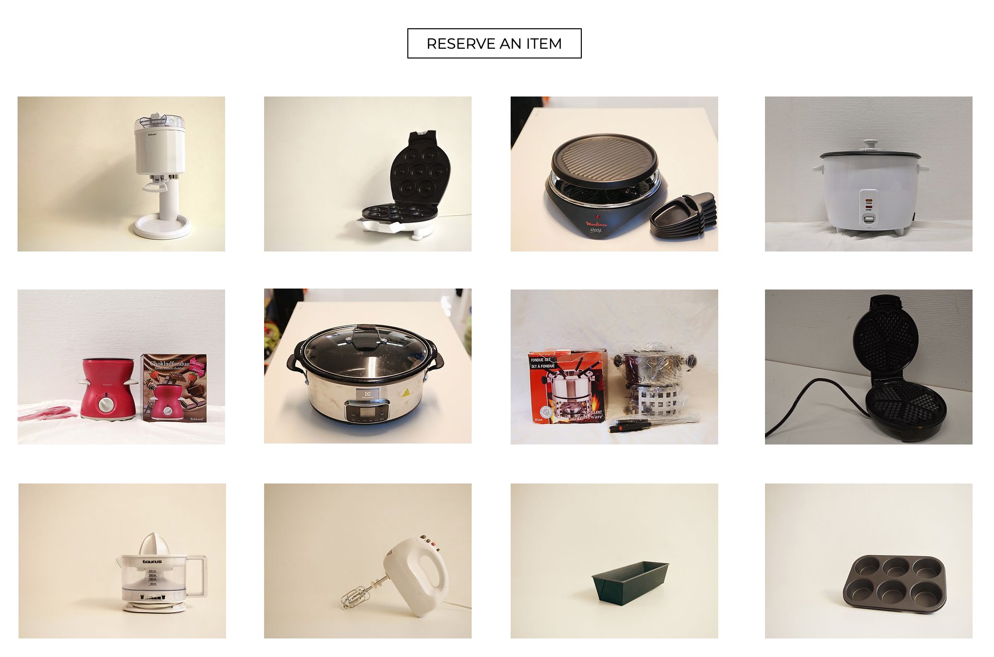
Description of the Case Study
Circle Centre is about sharing.
In order to fight overconsumption, Circle Centre created a “library of goods”, where items can be borrowed instead of being purchased. They can be borrowed for a short time (up to 2 weeks, and free of charge) and a long time (up to 12 months, and subjected to a small charge). The “library of goods” offers several kinds of items: whether it is outdoor, sport, art and crafts, kitchen, or electronic goods, the choice is wide. The image below shows an example of the online “library of goods”.
Circle Centre does not only become a place where to borrow items from, “but also a common workspace for personal projects”, where members can “work independently or collaboratively on their own DIY or art projects” (About l Circle Centre Lund, n.d.). For instance, one can bring a fabric and use the in-house sewing machine (ibid).
Finally, Circle Centre also becomes a place where educational events, workshops focused on sustainability, repair cafés, documentary screenings and open discussions are hosted.
Fig 1. Example of the items available on the “library of goods” in the section kitchen.

Slide 27
Value proposition
In order to tackle the increasing issue of overconsumption, which has several environmental and social impacts, Circle Centre offers a brilliant initiative based on sharing: a “library of goods”, where items can be borrowed instead of being bought. Circle Centre also offers a workplace for personal projects and a space for educational events and hands-on workshops/initiatives.

Slide 28
What makes it circular?
The circularity of the initiative “library of goods” lies within its sharing feature, which allocates it in the circular business model of “Product as a service or Product Service System (includes Sharing Economy)”.

Slide 29
Environmental and economic impact
Decreased waste generation.
Significant money saving.
Promotion of sharing, reuse and cooperation.
Increase of the intrinsic value of resourses, as the goods are continuously being reused.

Slide 30
References and useful info
References:
Circlecentrelund.org. n.d. About l Circle Centre Lund. [online] Available at: <https://www.circlecentrelund.org> [Accessed 21 October 2020].
Useful info:
Website: https://www.circlecentrelund.org
The related content to this case study has been identified from the public information which is published by the owners of the content.
Disclaimer:
The European Commission support for the production of this publication does not constitute an endorsement of the contents which reflects the views only of the authors, and the Commission cannot be held responsible for any use which may be made of the information contained therein.

Slide 31
Ecocheques
Belgium
Digitalisation, Sharing Platforms, and Services

Slide 32
Brief overview of the Case Study
Value proposition
Challenge
Encouraging consumers to choose environmentally-friendly products and services
A type of untaxable bonus that companies can pay to their staff which can only be spent on sustainable products and services
Impact or economic information
Description
Ecocheques are a kind of voucher, payable to private-sector employees, which may only be spent on certain green products and services.
Resource saving; reduction in the consumption of fossil fuels, energy, and water.

Slide 33
Description of the case study
Ecocheques are a popular initiative of the Belgian Labour Council which private companies in Belgium can use as a form of payment for their staff.
The difference between them and normal pay is that ecocheques are untaxable and can only be spent on selected environmentally-friendly products and services.
Employers can give each employee ecocheques worth up to €250 per year, valid for up to 2 years. The cheques themselves are not physical, paper vouchers; they come in the form of credit loaded onto a payments card.
Since 2009, ecocheques have allowed consumers to choose from a long list of things payable with ecocheques, including (but not limited to):
Second-hand electrical products
Recycled products
Products made from recycled/salvaged materials
Repair services
Bicycles, scooters (manual and electric)
A diverse range of other sustainable products and services.
Fig 1. Examples of types of second-hand products that can be bought with ecocheques. (MyEcocheques, 2020)

Slide 34
Value proposition
Ecocheques count as an untaxable bonus. This gives an incentive to both employer and employee. By diverting €250 a year into ecocheques, both employer and employee get to keep money which would otherwise have been paid in tax.
In this sense they work as a kind of indirect government subsidy for environmentally-friendly goods and services. They also create more consumer demand for them, giving these things an advantage over less sustainable alternatives.

Slide 35
What makes it circular?
By incentivising the purchase of a broad range of eco-friendly products and services, ecocheques are circular in terms of product life extension (repair services), resource recovery (recycled products), and circular inputs (products made of well-sourced, biodegradable/recyclable materials).

Slide 36
Environmental and economic impact
The year 2019 saw €256 million issued in ecocheques by 80 000 companies to 1.85 million members of staff.
Use of ecocheques in 2019 is estimated to have led to savings in CO2 emissions equal to the yearly emissions of 22 573 Belgians, or 0.23% of the national total.
41% of ecocheques are spent in local shops, 49% in specialist businesses, and only10% in supermarkets.
Ecocheques have the effect of channeling consumer spending to ecological and sustainable companies and sectors. This in turn creates profits and new jobs in those green companies/sectors.
(Ecocheque | VIA, 2020)
(Tondreau, 2017)

Slide 37
References and useful info
References:
Myecocheques.be. 2020. Myecocheques. [online] Available at: <https://www.myecocheques.be/> [Accessed 26 October 2020];
Circulareconomy.europa.eu. 2021. Eco-Vouchers Encourage Sustainable Consumption, Including Second-Hand And Refurbished Goods | European Circular Economy Stakeholder Platform. [online] Available at: <https://circulareconomy.europa.eu/platform/en/good-practices/eco-vouchers-encourage-sustainable-consumption-including-second-hand-and-refurbished-goods> [Accessed 12 January 2021].
Viabelgium.be. 2020. Ecocheque | Voucher Issuers Association Belgium. [online] Available at: <http://www.viabelgium.be/nl/les-principaux-produits-nl/ecocheque/index.html> [Accessed 1 December 2020];
Tondreau, Grégoire, 2017. De Voordelen Van Het Systeem Van Ecocheques T.O.V. Een Netto-Equivalent. [online] Viabelgium.be. Available at: <http://www.viabelgium.be/wp-content/uploads/2017/03/ecocheque-netto-equivalent-2017-nl.pdf> [Accessed 1 December 2020].
Useful info:
http://www.myecocheques.be/
The related content to this case study has been identified from the public information which is published by the owners of the content.
Disclaimer:
The European Commission support for the production of this publication does not constitute an endorsement of the contents which reflects the views only of the authors, and the Commission cannot be held responsible for any use which may be made of the information contained therein.

Slide 38
Som Energia
Renewable energy solutions
Digitalization, Sharing Platforms, and Services in Spain

Slide 39
Brief overview of Som Energia
Challenge
Value proposition
The current energy model based on fossil fuels is unsustainable. Nowadays, energy consumers have too little ability to influence the decision-making processes in traditional energy providers.
Som Energia is a cooperative where all partners have a voice and vote in the decisions of the company.
Impact or economic information
Description
The company is a non-profit green energy consumer co-operative. Its main activities are the commercialisation and production of renewable energy and it is committed to promoting change in the current energy model to achieve a 100% renewable model.
Reduction in energy consumption, reduction in CO2 emissions, creation of green jobs, increase in social participation in the energy consumption process.

Slide 40
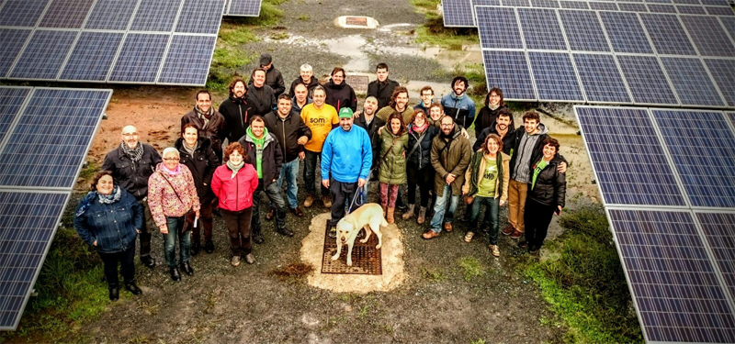
Description of Som Energia
Som Energia was born in 2010 in Catalonia, Spain. It is a consumer cooperative set up as a non-profit which produces and commercialises renewable energy. The company is committed to promoting a change in the current energy model to achieve a 100% renewable model. They also aim to make the whole process of energy consumption more participative in order to empower consumers.
What do they do?
Production: They produce electrical energy in generation facilities from renewable sources (sun, wind, biogas, biomass) financed by donations from partners.
Commercialisation: They manage, buy, and provide bills for the electricity consumed by their members, according to certificates of guarantee of origin. Individuals and companies can acquire energy from them without the need for any rewiring or electrician’s services.
(Som Energia, 2020)

Slide 41
Value proposition
Som Energia offers an alternative to traditional energy suppliers not only by using 100% renewable energy, but also by involving the consumer through their participatory management set-up as a non-profit cooperative.
Since its creation in 2012, Som Energia has become one of the best examples of the cooperativism in the energy sector in Spain.

Slide 42
What makes it circular?
Making the energy-consumption process accessible and participatory through local groups, aiming to create an innovative movement.
Promotion of a green and efficient economic model in which citizens are key.
Favouring the growth of a more social and solidarity-based economy.
Reducing the market power of the major energy suppliers that have traditionally dominated the market
Creating in a social movement that promotes transparency and change.

Slide 43
Environmental and economic impact
The cooperative started with 150 members. By 2020, this had already risen to 66 000 members receiving energy through 108 000 contracts.
Is seeing rapid growth in its provision of renewable energy. Provided 32% more energy in 2019 than in the previous year.
Transparent leadership and decision-making with participation of the consumers in the process. Decentralised into 53 local groups spread across Spain.
Generation of green jobs such as for solar panel installers, green energy agents, and others. By the end of 2019 the company employed 73 people, with almost gender parity.

Slide 44
References and useful info
References:
Som Energia. 2020. Som Energia | La Cooperativa De Energia Verde. [online] Available at: <https://www.somenergia.coop/es/>
años, S. and F., A., 2020. Panorama - Som Energia Cumple Diez Años - Energías Renovables, El Periodismo De Las Energías Limpias.. [online] Energías Renovables, el periodismo de las energías limpias. Available at: <https://www.energias-renovables.com/panorama/som-energia-cumple-diez-anos-20201013/> [Accessed 28 October 2020].
El Blog de Som Energia. 2020. Som Energia Crece En Casi 10.000 Personas Socias Y Comercializa Un 32% Más De Electricidad Respecto Al Año Anterior - El Blog De Som Energia. [online] Available at: <https://blog.somenergia.coop/comunicados-prensa/2020/06/som-energia-crece-en-casi-10-000-personas-socias-y-comercializa-un-32-mas-de-electricidad-respecto-al-ano-anterior/> [Accessed 15 December 2020].
The related content to this case study has been identified from the public information which is published by the owners of the content.
Disclaimer:
The European Commission support for the production of this publication does not constitute an endorsement of the contents which reflects the views only of the authors, and the Commission cannot be held responsible for any use which may be made of the information contained therein.

Slide 45
Together we cultivate solidarity! Bio&Co
Food and Biomass (Agriculture, Forest, Food and Energy), Romania

Slide 46
Brief overview of the Case Study
Challenge
Value proposition
A large amount of food is wasted every year. A part of the food is represented by bio-degradable materials that could be recycled by composting.
The Bio&CO model promotes a responsible waste management process, and foster solidarity and responsibility for sustainable development.
Impact or economic information
Description
Impact on comunity trough the support of local consumption of organig food; food diverted from waste and used as compost in organig farming; Green Jobs for people at risk of poverty
Bio&Co collects food waste and uses it together with crop residues to make compost, which is used in organic farming

Slide 47
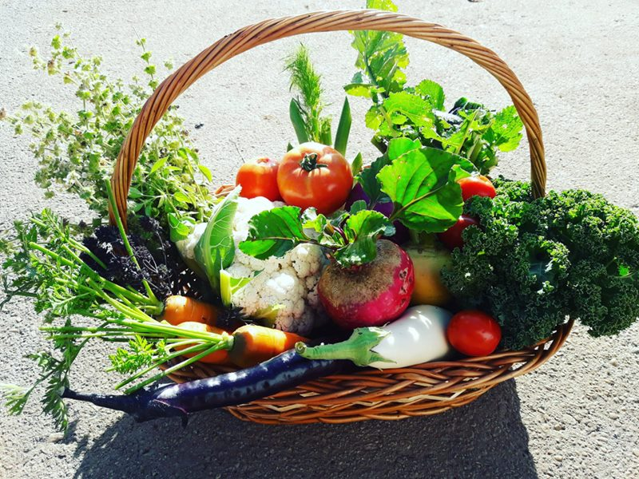
Description of the Case study
Bio&Co is a local project of the NGO “Ateliere fara frontiere” and produces locally grown vegetables, respecting ecological norms, which are further on distributed in a short circuit directly to the consumer, without polluting by transport for hundreds or thousands of kilometers.
As they are a social farming, waste is recycled on the composting platform together with food waste from supermarkets, or restaurants and hotels. In this way, the food waste is reuse or composting to produce natural fertilizer for organic farming. Ateliere fara frontiere association which implements the project, uses four hectares of agricultural land and 4000 m2 of solariums through which it produces 80 varieties of vegetables grown according to the principles of organic agriculture, vegetables delivered to 160 consumers -tori subscribers.
In addition, the NGO also has a 1000 sq m platform for composting food and organic waste collected from its own farm, but also from restaurants, hotels and supermarkets. The organic farm, where all the resulting waste is recycled on the composting platform, is an example of a circular bioeconomy.

Slide 48
Value proposition
In order to tackle the huge amount of food waste, Bio&Co model promotes the reduction of food waste by collecting organic waste produced by supermarkets, restaurants or hotels and reusing it for compost. Bio&Co also promotes a balanced and healthy diet for all, building a food solidarity program for needy families and disadvantaged people. Additionally, they pay attention to the environment, growing locally and using as few packaging as possible.

Slide 49
What makes it circular?
Resource Recovery
The organic farm is an example of circular economy of biological flows, because all waste is recycled on the composting platform together with food waste from supermarkets. Also, to the protection of the environment and the preservation of biodiversity, soil quality, air and groundwater, respecting the European and national norms of organic farming and integrating the principles of sustainable development in everything they do.

Slide 50
Environmental and economic impact
contributes to the protection of the environment and the preservation of biodiversity, soil quality, air and groundwater, by growing locally and respecting the European and national norms of organic farming
supports local consumption of organic food trough the programme food solidarity for needy families and disadvantaged people (over 4783 vegetable baskets delivered to over 200 subscribers)
Contributes to create green jobs, (20 green jobs for people at risk of poverty and exclusion were created)
reduce of waste and pollution by collecting food and organic waste and composting them, turning them into fertilizer for agriculture BIO

Slide 51
References and useful info
References:
http://www.bio-co.ro/
Useful info:
https://www.interregeurope.eu/policylearning/good-practices/item/1894/social-enterprise-in-composting-and-organic-farming
The related content to this case study has been identified from the public information which is published by the owners of the content.
Disclaimer:
The European Commission support for the production of this publication does not constitute an endorsement of the contents which reflects the views only of the authors, and the Commission cannot be held responsible for any use which may be made of the information contained therein.

Slide 52
Municipal Waste Management Program in Krakow
Food and Biomass (Agriculture, Forest, Food and Energy)
(Identified case study from the research in Poland)

Slide 53
Brief overview of the Case Study
Value proposition
Challenge
Waste is disposed of using the thermal waste disposal method. Energy is harnessed from the process and recycled back into the community.
Efficiently eliminating waste while harvesting clean energy.
Impact or economic information
Description
The program fulfills sanitation needs and provides low-cost energy.
The program addresses pressing waste disposal needs while also generating clean energy.

Slide 54
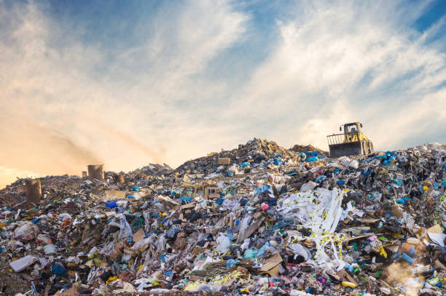
Description of the Case study
The “Municipal Waste Management Program in Krakow” program addresses the important threat to the world’s environment presented by landfills. This problem is becoming increasingly more relevant as scientists have indicated the environmental harm suffered by areas situated around landfills, as well as the potential health risks presented to humans by improper disposal of waste. The “Municipal Waste Management Program in Krakow” uses the thermal waste conversion method to hygienically dispose of waste and extract clean energy from the process of disposal. Harmful gases are incinerated during the process, as the temperature generally is above 850 °C.
The residual heat from the process converts water passing through the boiler into steam. The resulting steam then propels a turbine engine, which so produces clean electricity. The electricity powers the waste management plant, and excess energy enters the GPZ Wanda station and provides a source of municipal energy.
Source: http://old.ekospalarnia.krakow.pl

Slide 55
Value proposition
This project fulfills two pressing needs: sanitary waste management and clean energy production. The project seamlessly connects these two points together in a single location. The surrounding area is benefited by being relieved of its waste and receiving cleanly generated energy.

Slide 56
What makes it circular?
The project is made circular by time its extraction of clean energy from the environmentally- friendly incineration of urban-generated waste. Specifically, its circularity lies within the “thermal waste disposal” method, which allocates it within the “Resource Recover” business circular model.

Slide 57
Environmental and economic impact
By extracting energy from waste disposal, less environmentally friendly methods of energy usage are avoided and fossil fuel resources are conserved as their usage may ultimately be reduced.
The generation of clean energy opens the potential to reduce reliance on environmentally-damaging means of energy.
Human health is relieved from the effects of the toxic presence of landfills, which do not only harm the environment, but human- wellbeing as well.
Air quality in the surrounding area is improved by the lack/reduction of land fills.
Source: Ekospalarnia Kraków. Krakow Holding Komunalny Spółka Akcyjna w Krakowie. Krakow.
https://khk.krakow.pl/pl/ekospalarnia

Slide 58
References and useful info
References:
Ekologiczna Spalarnia Odpadów w Krakowie. Krakowski Holding Kommunalny S.A. W Krakowie. Krakow. (visited 01.12.2020) http://old.ekospalarnia.krakow.pl
Ekospalarnia Kraków. Krakow Holding Komunalny Spółka Akcyjna w Krakowie. Krakow.(visited 01.12.2020) https://khk.krakow.pl/pl/ekospalarnia
Jagoda Gołek-Schild. (2018) „Instalacje termicznego przetwarzania odpadów komunalnych w Polsce – źródło energii o znaczeniu środowiskowym”. Zeszyty Naukowe. 2018, nr 105, s. 147–156 DOI: 10.24425/124370.
Useful Info
Dariusz Sala and Bogusław Bieda. (2019) „The Thermal Waste Treatment Plant in Kraków, Poland: A Case Study”. InTech Open.
https://www.intechopen.com/books/innovation-in-global-green-technologies-2020/the-thermal-waste-treatment-plant-in-krak-w-poland-a-case-study
The related content to this case study has been identified from the public information which is published by the owners of the content.
Disclaimer:
The European Commission support for the production of this publication does not constitute an endorsement of the contents which reflects the views only of the authors, and the Commission cannot be held responsible for any use which may be made of the information contained therein.

Slide 59
LUFA FARMS
Food and Biomass (Agriculture, Forest, Food and Energy)
Identified case study from the research at International level (Canada)

Slide 60
Brief overview of the Case Study
Challenge
Value proposition
Rural land is becoming more degraded and constantly pushed back as cities expand. Food value chains need to become more sustainable
It combines innovative rooftop hydroponic farming with an online market that includes like-minded local producers
Impact or economic information
Description
They started by creating a business around rooftop farms and now their Marketplace serves as a source of locally produced vegetables in Montreal.
While many urban farmers struggle to make a living, Lufa Farms has proven as a profitable solution for local production

Slide 61
Description of the Case study
Lufa Farms built the world’s first commercial rooftop greenhouse on an industrial building in Montreal, Quebec, to prove that high-yield, year-round farming is a smarter, more sustainable, and commercially viable way to feed cities. Since then, they’ve built new, bigger and better rooftop greenhouses, to grow more and more vegetables (About l Montreal Lufa, n.d.).
Being in a rooftop allows them to use rainwater and use the residual heating from the buildings. The closed-loop hydroponic system they use recirculates water and nutrients saving more than 50% of water than a conventional farm (Ibid).
Rooftop farms aren’t meant to replace local farms and food makers (not everything can be grown on rooftops after all). Altogether, Lufa Farms and their partners are building a healthier, more sustainable local food system. They seek out partners who share their values of transparency and sustainability and work closely with them for their online farmer’s market, the Marketplace, to offer locals a full selection of products (Ibid).
Fig 1. Lufa Farm rooftop hyfdroponic farm (About l Montreal Lufa, n.d.)

Slide 62
How does Lufa Farms work everyday?
Over the years they developed a community of hundreds of neighbourhood pick-up points to get food from their rooftops and partners to “Lufavores” (how they call their clients) as directly as possible. Their goals are efficiency, convenience, and community-building. They also have a fleet of electric cars to supply eco home delivery (About l Montreal Lufa, n.d.).
As they affirm,“reinventing a broken food system without a community is unthinkable”, so on Lufa Farms communicate with their clients daily and have their doors open for community visits and open houses, for people “to know their farmer, know their food, know where it’s from and how it’s grown” (Ibid).
Their local partners are all like-minded farmers and food makers who share Lufa Farms’ values of proximity, quality, transparency, and sustainability. Every producer wishing to sell on their Marketplace must meet Lufa Farms standards and ensure that their products are excellent and truly responsibly produced (Ibid).
Fig 2. Local farm in Montreal (About l Montreal Lufa, n.d.)

Slide 63
Value proposition
Business model that combines innovative rooftop hydroponic farming with an online market that includes different producers at a local level where the client can purchaise their vegetables on a subscription basis.
It promotes sustainable and local food production, making it easier for the consumer to reach the producers.

Slide 64
What makes it circular?
Circular inputs
Cities have acres of unused roof space which can be used to grow crops.
Rooftop farms are perfect for rainwater irrigation as well as benefiting from free energy from the sun and residual heat rising from the buildings below.
Building and city infrastructure can also benefit as rooftop farms provide cooling/insulation as well as attenuate run-off.
Hydroponic system allows recirculation of nutrient-rich irrigation water.
Dematerialisation
Distribution costs are greatly reduced as a result of promoting local production both in rooftop hydroponic farms and nearly like-minded farms.

Slide 65
Environmental and economic impact
Less than one acre of roof produces enough fresh products each year to feed 2000 people
Rooftop farms use:
• 50% less heating energy
• 50 - 90% less water and nutrients and reduce energy demands on the building underneath
It now delivers more than 10,000 baskets of food every week feeding about 2 percent of the population in that area.
The subscription model allows them to harvest to order for each day, reducing food waste

Slide 66
References and useful info
References:
montreal.lufa.com. n.d. About. [online] Available at: < https://montreal.lufa.com/en/about> [Accessed 20 October 2020].
ellenmacarthurfoundation.org. n.d. High yields high above the city. [online] Available at: < https://www.ellenmacarthurfoundation.org/case-studies/high-yields-high-above-the-city > [Accessed 20 October 2020].
Useful info:
https://www.youtube.com/watch?v=kSQm09twKEE
https://www.flickr.com/photos/lufafarms/albums/72157681666196856
https://urbanecologycmu.wordpress.com/2015/10/20/lufa-farms-food-systems-case-study/
The related content to this case study has been identified from the public information which is published by the owners of the content.
Disclaimer:
The European Commission support for the production of this publication does not constitute an endorsement of the contents which reflects the views only of the authors, and the Commission cannot be held responsible for any use which may be made of the information contained therein.

Slide 67
Recupel
Plastics, Secondary Materials, and Innovation
Case study identified in the research in Belgium

Slide 68
Brief overview of the Case Study
Value proposition
Challenge
Collection of e-waste for its repurposing. Consumers being able to get rid of electronic devices easily, companies benefiting from Recupel’s services.
Reducing e-waste (waste coming from electronic products).
Impact
Description
Saving of resources, reduction in the total amount of energy consumed, green job creation.
Recupel collects e-waste all across Belgium through drop-off points in places such as shops. Collaborating with producers, importers, and sellers, they contribute to and support the repurposing of e-waste.

Slide 69
Description of the case study
Recupel works all across Belgium to collect e-waste for various purposes.
They run collection points for electronic waste in public places such as shops, where anyone may drop off those products.
Recupel also cooperates with producers, importers, and sellers of electronic devices on the Belgian market to facilitate the collection of the devices. Through Recupel, such companies can fulfill their legal requirement to ensure safe and environmentally friendly disposal of these products. By joining Recupel as a member and paying a membership fee, businesses ensure that this will instead be handled by Recupel.
For all household (i.e. non-company) appliances, a “Recupel contribution” is charged to the purchaser at the point of purchase, which covers the device’s disposal costs for Recupel.
Recupel then either sends items to “reuse centres” to be put back into use, if still functional, or dismantles them to extract the raw materials for reprocessing and reuse if the device is no longer usable.
Fig 1. A screenshot from the website of Recupel showing how it informs users of what can be recycled.

Slide 70
Value proposition
For everyday consumers: getting rid of devices, knowing they will not generate waste but will be repurposed,
For companies producing, importing, and selling electronic devices: saving a significant amount of work in having to dispose of electronic items bought for commercial purposes.
Other services: informational service on what e-waste can be recycled
if Recupel do not take it themselves, they point consumers in the direction of where they can go to get it recycled.

Slide 71
What makes it circular?
Recupel is circular in that it facilitates product life extension in terms of the products it sends to re-use centres, as well as promoting resource recovery through the raw materials it extracts from non-reusable ones.

Slide 72
Environmental and economic impact
Over 7 000 collection points in use as of 2018.
122,548 tonnes of electrical and electronic
appliances collected in 2019
90% of e-waste put to good use in 2019
79.3% is recycled,
10.7% is incinerated, with the heat generated being recovered and used as an energy of heat source
Result per material stream:
Ferrous materials: 99.99%
Non-ferrous materials: 99.98%
Plastics: 95.47%
Other materials: 65.71%
(Over 117,000 tonnes of electrical and electronic appliances collected in 2018, 2019)

Slide 73
References and useful info
References:
Recupel.be. 2019. Over 117,000 Tonnes Of Electrical And Electronic Appliances Collected In 2018. [online] Available at: <https://www.recupel.be/en/blog/over-117-000-tonnes-of-electrical-and-electronic-appliances-collected-in-2018-discover-our-new-annual-report/> [Accessed 30 October 2020].
Useful info:
https://www.recupel.be/
https://annualreport.recupel.be/processingresults-en/#tabs
The related content to this case study has been identified from the public information which is published by the owners of the content.
Disclaimer:
The European Commission support for the production of this publication does not constitute an endorsement of the contents which reflects the views only of the authors, and the Commission cannot be held responsible for any use which may be made of the information contained therein.

Slide 74
SIPTex
Plastics, Secondary Materials, and Innovation
Identified case study from the research in Sweden

Slide 75
Brief overview of the Case Study
Value proposition
Challenge
Elevated negative environmental impact of the textile industry: need for reuse and recycle of textiles.
Given the negative environmental impact within the textile sector, SIPTex offers an innovative bridge between waste textiles and high quality recycled products.
Impact or economic information
By increasing circularity in the textile value chain, the benefits are not only environmental, but also economic and social.
Description
SIPTex is the world's first automatic large-scale textile sorting plant.

Slide 76
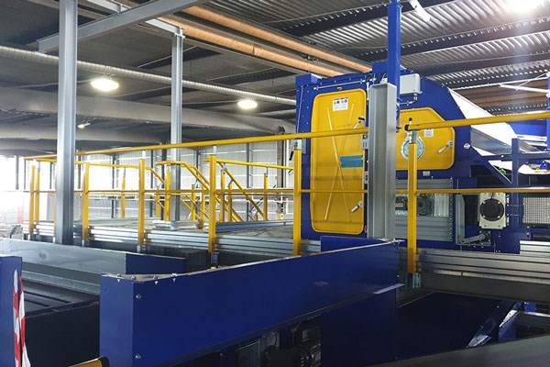
Description of the Case Study
Every year, in Sweden, each person buys over 13 kg of textiles, of which around 8 kg is thrown away (Sysav -Sydskånes avfallsaktiebolag, 2017). “20% of the textiles are collected for reuse, but only around 5% are recycled” (ibid). Sweden therefore holds a great potential in improving and increasing reuse and recycling rates.
However, when it comes to recycling, “it is difficult to sort different types of textile fibres manually. Besides, many garments consist of mixed materials” (ibid). And, this is where SIPTex (Swedish Innovation Platform for Textile Sorting) takes action.
Funded by Vinnova, and led by IVL Swedish Environmental Institute, together with a broad consortium, SIPTex is the world's first automatic large-scale textile sorting plant (see Fig. 1).
SIPTex contributes to the transformation of large amounts of textile waste into high quality recycled products: an essential step to create a circular cycle for textiles (Sysav, 2019).
Fig .1 Image of the plant. Image’s source: Siptex | Sysav – tar hand om och återvinner avfall (n.d.).

Slide 77
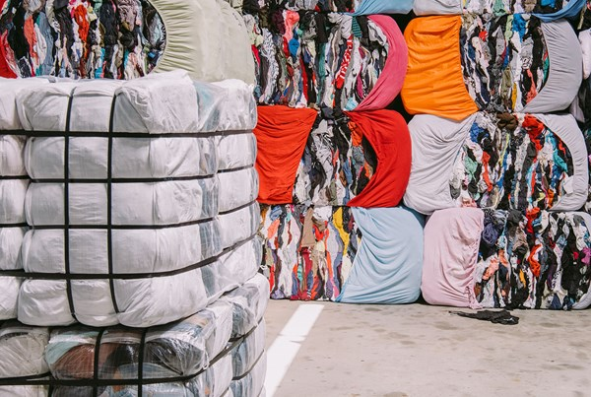
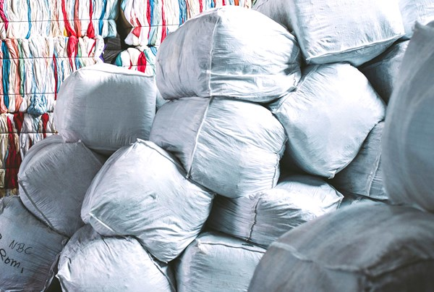
How does the machine work?
“The sorting machine uses optical sensors to identify the textile type. The machine can be programmed to sort, for example, white garments of 100% cotton. Then an infrared light is used on the garments. Different materials absorb different wavelenghts of light. The sensors then register the dispersed light, that forms a spectrum. Based upon this spectrum, the machine can determine the type of fibre the garment is made of. For example, 100% cotton. The technology allows for sophisticated sorting, with high precision and purity for different fibres. The sorting solution is tailored to the material recyclers’ requirements and needs” (Sysav -Sydskånes avfallsaktiebolag, 2017).
SIPtex allows to close the loop and to put large volumes of textile back into the society.
Fig. 2 Image showing the materials when they enter the plant.
Fig. 3 Image showing how the sorted materials look like once they are about to leave the plant.
Images’ source: Siptex | Sysav – tar hand om och återvinner avfall (n.d.).

Slide 78
Value proposition
A change within the textile sector is highly needed as it is one of the sectors with the highest negative environmental impacts. SIPTex therefore offers an innovative bridge between waste textiles and high quality recycled products, contributing “to increased circularity in the textile value chain” and strengthening “Sweden's position as a pioneer in innovation and circular economy” (Siptex | Sysav – tar hand om och återvinner avfall, n.d.).

Slide 79
What makes it circular?
SIPTex allows to extend the life of textiles that would have otherwise been thrown away. This feature allocates SIPTex in the circular business model of “Product life extension”.

Slide 80
Environmental and economic impact
SIPTex leads to the creation of “functional markets for recycled textiles”, as well as to “established automated textile sorting capacity in Europe” (Sysav, 2019).
Increased “circularity in the textile value chain” (ibid).
Contribution to a “secured supply of raw materials for textile producers” (ibid).
Only about 5% of the total disposed clothes is recycled in Sweden (Sysav -Sydskånes avfallsaktiebolag, 2017). SIPTex contributes to increase recycling rates.

Slide 81
References and useful info
References:
Sysav. n.d. Siptex | Sysav – Tar Hand Om Och Återvinner Avfall. [online] Available at: <https://www.sysav.se/en/siptex/> [Accessed 22 October 2020].
Sysav, 2019. Världsunik Anläggning För Textilsortering I Malmö. [online] Available at: <https://www.sysav.se/om-oss/pressrum/pressmeddelande/varldsunik-anlaggning-for-textilsortering-i-malmo--2928729/> [Accessed 22 October 2020].
Sysav -Sydskånes avfallsaktiebolag, 2017. Recycle your old socks!. Available at: <https://www.youtube.com/watch?v=Mppx3OXO-jA&feature=youtu.be> [Accessed 19 November 2020].
Useful info:
Sysav’s website: https://www.sysav.se/en/siptex/.
The related content to this case study has been identfied from the public information which is published by the owners of the content.
Disclaimer:
The European Commission support for the production of this publication does not constitute an endorsement of the contents which reflects the views only of the authors, and the Commission cannot be held responsible for any use which may be made of the information contained therein.

Slide 82
Water2Return
Water treatment and reuse
Identified case study from the research in Spain

Slide 83
Brief overview of Water2Return
Challenge
Value proposition
The EU slaughtering sector, characterised by its high water and energy consumption, produces large amounts of wastewater (~750,000 m3 /year), containing relevant nutrients that are daily discarded.
A circular economy approach to turn wastewater treatment facilities in slaughterhouses into “bio-refineries” to recover valuable nutrients and water
Description
Impact or economic information
W2R proposes a process using biochemical and physical technologies and a positive balance in energy footprint to be implemented in a real case study, the slaughterhouse “Matadero del Sur” (Salteras, Spain).
Wastewater discharged reduction: 9 0%
Fresh water savings: 20-40% in the meat industry
Nutrients recovery: 90-95%

Slide 84
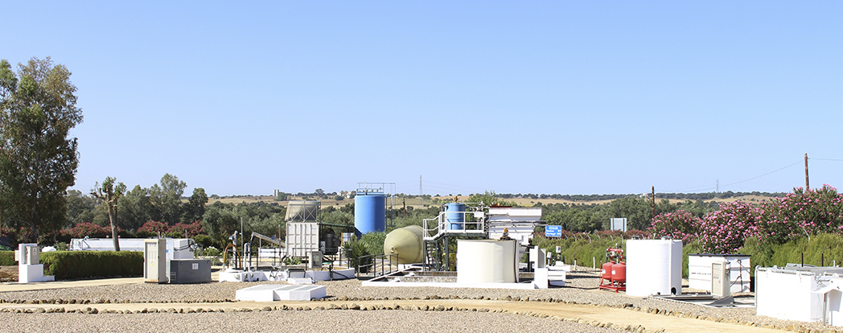
Description of Water2Return
Water2Return is a real technological breakthrough based on a Circular Economy approach. It aims to treat slaughterhouses’ wastewaters and recover nutrients with high market value that can be injected back into the economy as new raw materials, becoming a resource and not a waste anymore. Thus, maximum value from slaughterhouse waste extraction, supply security increase and landfilling/emissions avoidance are achieved.
W2R proposes an integrated full-scale demonstration process (treatment capacity: 50 m3 wastewater/day) in cascade using biochemical and physical technologies and a positive balance in energy footprint to be implemented in a real case study, the slaughterhouse “Matadero del Sur” (Salteras, Spain).
Fig 1. W2R pilot plant at “Matadero del Sur”

Slide 85
Outcomes of the Project Water2Return:
Integrated system to treat wastewater while recovering nutrients consisting of a novel combination of technologies and processes in cascade maximising the extraction of valuable products. The system can be customised according to the needs of the end user.
3 different raw materials which will be the basis for further manufacturing the agronomic products. These raw materials, concretely nitrate and phosphate concentrate, hydrolysed sludge and algal biomass, will be obtained at different stages of the process.
3 agronomic products manufactured in production lines built up within the Water2REturn project, free of pathogens and pollutants and ready to be commercialised: 1 organic fertiliser and 2 biostimulants, that will enhance nutrition efficiency, abiotic stress tolerance and/or crop quality traits.

Slide 86
Value proposition
Water2Return offers a circular economy approach to turn wastewater treatment facilities in slaughterhouses into “bio-refineries”, addressing water scarcity while simultaneously recovering valuable resources.

Slide 87
What makes it circular?
Resource recovery
Water2Return is built on a bottom-up approach based on a current market demand. It constitutes a real technological breakthrough conceived to recover and recycle nutrients from slaughterhouse wastewater in the framework of a Circular Economy model.
Nutrients recovered are turned into value added products for the agro-chemical industry and, consequently, for the agricultural sector, that seeks more sustainable products fulfilling the increasingly restrictive legislation requirements.
At the same time, slaughterhouses solve their wastewater management problems, and reduced costs related to water consumption by reusing the water.

Slide 88
Environmental and economic impact
Potential production more than 4% (of total chemical N-fertilisers consumed in EU).
30% Costs Savings. Treatment costs:
Conventional solutions: 2.63 €/m3
Water2REturn system: 1.85 €/m3
Payback period:
APs production lines: 2.38 years
Wastewater treatment system: 6,98 years
Wastewater discharged reduction: 90%
Fresh water savings: 20-40% in the meat industry
Nutrients recovery: 90-95%

Slide 89
References and useful info
References:
Water 2 Return. 2020. The Project - Water 2 Return. [online] Available at: <https://water2return.eu/the-project/> [Accessed 28 December 2020].
The related content to this case study has been identified from the public information which is published by the owners of the content.
Disclaimer:
The European Commission support for the production of this publication does not constitute an endorsement of the contents which reflects the views only of the authors, and the Commission cannot be held responsible for any use which may be made of the information contained therein.

Slide 90
Proeko: Industrial Water Filters
Water Treatment and Reuse
Identified case study from the research in Poland

Slide 91
Brief overview of the Case Study
Challenge
How to treat the mineral and chemical components of water while efficiently using raw materials and reducing the generation of waste and emissions being released into the environment.
Value proposition
Modern water filtration solutions for an effective water treatment to all who need them. (Contamination and Geo-tech Expo . „Proeko. Stand: 4-G90”. RoarB2B. https://www.contaminationexpo.com/exhibitors/proeko)
Impact or economic information
Description
Proeko’s water filters enable individuals to benefit from clean drinking water, while the local environment benefits from from the lack of harmful pollutants being released from unsafe filtration. (Ibid).
PROEKO provides innovative water treatment solutions for individuals, industries, and institutions (Ibid).

Slide 92
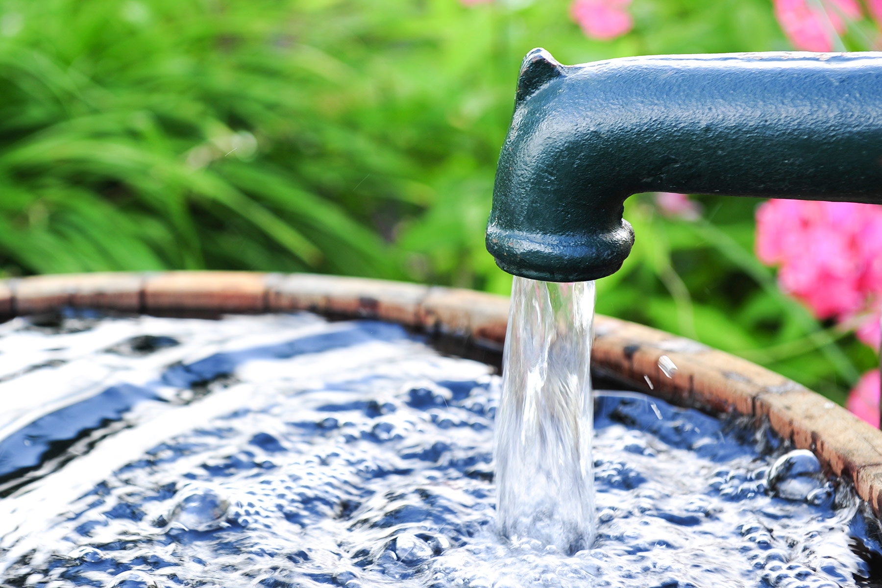
Description of the Case study
The modern world struggles with various threats from pollution. These harm the environment, the water system, animals in the local area, as well as human beings. PROEKO works to provide individuals, industries, and firms with water purification solutions that address the concerns of their daily lives, while at the same time considering immediate and long-term impacts on the environment.. It works across a wide spectrum of water testing; everything from making analyses of chemical content in water to designing individual solutions to understanding how best to help customers while also protecting the environment.
PROEKO works directly with its customers and fulfills an advisory role in the process of identifying which type of technology is necessary for their water needs and can assist with installation as well. Finally, PROEKO conducts user-training for all its products to guarantee wise and effective usage, and so guarantee the safety of individuals and preserve the health of the environment. (PROEKO. 2008. Proeko Industrial Water Filters. http://proekojp.com/research-projects/)
Image from WebMD. https://www.webmd.com/a-to-z-guides/ss/slideshow-drink-enough-water)

Slide 93
Value proposition
Proeko’s inherent value lies in its ability to formulate and implement ecologically- friendly, effective water treatment solutions to all who need them. It utilizes its products in such a way that local water resources are able to be purified and delivered to the individuals who benefit from the clean drinking water. Pressure on the environment is limited with the reduction of emissions from the filtration process

Slide 94
What makes it circular?
PROEKO may be considered circular due to its treatment of water which allows for the usage and availability of clean water and reduction of emissions and chemicals entering the environment. The circularity of the initiative lies within delivery of water filtration solutions to customers, which allocates it to the circular business model

Slide 95
Environmental and economic impact
PROEKO reduces costs by operating without power supply needs. An unlimited amount of water is provided by its redistillation offer.
(PROEKO. 2008. Proeko Industrial Water Filters. http://proekojp.com/research-projects/)
Services are cost effective as all PROEKO products have a 10 - year guarantee; needed spare parts are available for up to two years after purchase. (Ibid.)
Green jobs creation:
PROEKO produces the need for jobs which may be termed “green” due to work in purifying water and preventing water-waste.
In addition to products and services, PROEKO also researches and develops products to propel research forward in the field of water purification and to investigate its acidification. (Ibid.)

Slide 96
References and useful info
References:
PROEKO. 2008. Proeko Industrial Water Filters. http://proekojp.com/research-projects/
„Proeko”. Environmental Expert .https://www.environmental-expert.com/companies/proeko-36228
Contamination and Geo-tech Expo . „Proeko. Stand: 4-G90”. RoarB2B. https://www.contaminationexpo.com/exhibitors/proeko
Useful info:
To find out more about thermal waste reduction, please follow this link from the The Government of the Hong King Special Administrative Region, Environmental Protection Department: https://www.epd.gov.hk/epd/english/environmentinhk/waste/prob_solutions/WFdev_IWMFtech.html
The related content to this case study has been identified from the public information which is published by the owners of the content.
Disclaimer:
The European Commission support for the production of this publication does not constitute an endorsement of the contents which reflects the views only of the authors, and the Commission cannot be held responsible for any use which may be made of the information contained therein.

